Slide 1
TSN Project

Slide 2
IEEE 802.1Qbv
Focuses on Scheduled Traffic via the Time Aware Shaper
TAS is designed to send traffic in fixed time cycles of equal size
We use guard bands to stop frames from being transmitted too late in the cycle to stop them overflowing into the next cycle and interfering with critical traffic
Conversely, we do we do not guard against critical traffic overflowing as it is critical
Traffic flow during each cycle is determined by queues connected to gates with different classes of traffic
Each queue could have a different selection algorithm on which frame is next to go through the gate
The are 8 gates that can be open or closed encoded by a pre-determined Gate Control list (GCL)
The goal is to reduce latency variation for frames with known timing
Helps TSN to be more deterministic

Slide 3
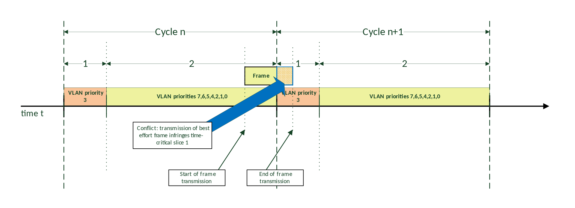
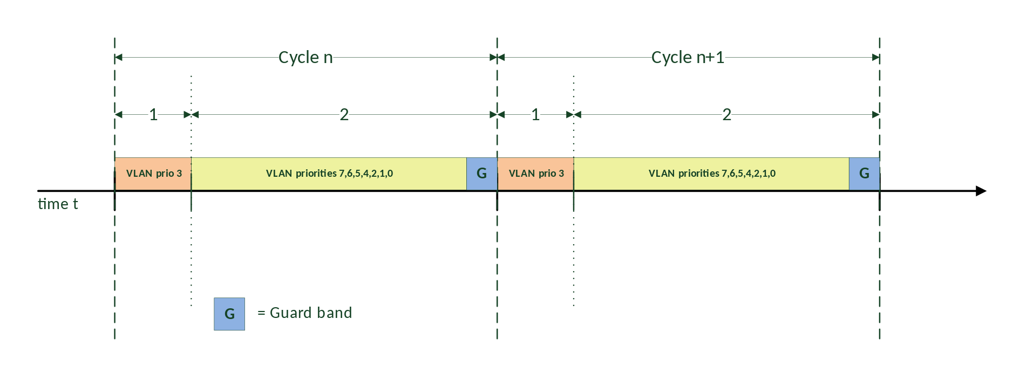
Guard Bands Example
From Wikipedia
Notes:
The top picture shows a frame overflowing into a critical section
The bottom picture shows how we can use a guard band before a critical section to say no more frames can be sent from this point so it doesn’t interfere with critical section
https://en.wikipedia.org/wiki/Time-Sensitive_Networking#TSN_scheduling_and_traffic_shaping

Slide 4
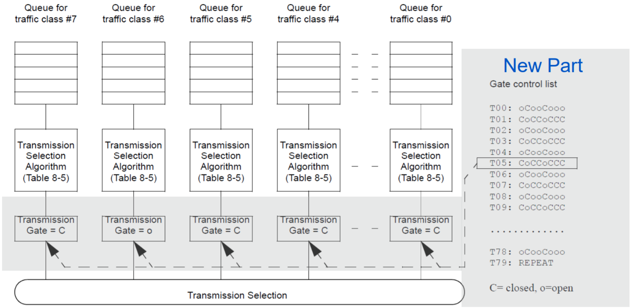
GCL and Scheduling Example
From ieee.org
Notes:
https://www.ieee802.org/1/files/public/docs2017/tsn-farkas-intro-0517-v01.pdf#page=27

Slide 5
IEEE 802.1Qbu
Focuses on Frame Pre-emption
Each traffic class (queue) seen in the slide above is assigned a frame pre-emption value
This can either be express or preemptable (eMAC, pMAC)
Being able to pre-empt non-critical frames allows us to make the guard band seen earlier much smaller
It can be the same size as the largest possible interfering fragment rather than largest possible interfering frame
The pre-empted packed is then resumed in the next cycle after the critical section
This is because there is a layer that stores the remaining frame and then sends it when out of the critical section
This pre-emption is only on a switch -> switch basis and not over longer distances
Each frame is stored with a CRC32 check which is inverted so the switch knows that it is only a part of the frame
The goal of this is to keep the guard bands so to not interfere with time critical traffic, but to also maximise efficiency in having as small a guard band as possible so the network is not idle

Slide 6
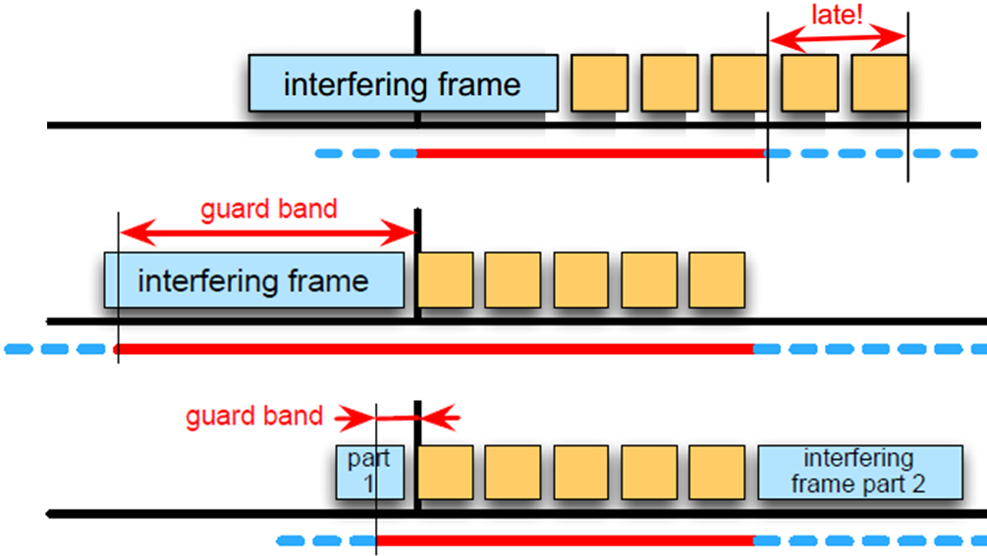
Smaller Guard Band Size Example
Notes:
Shows the comparison between the size of the guard band with and without pre-emption, as well as the effect of no guard band
https://drive.google.com/file/d/0B6Xurc4m_PVsZ1lzWWoxS0pTNVE/view

Slide 7
Current Simulation Methods

Slide 8
What Are They Missing?

Slide 9
New Simulation Proposal

